Slide 1
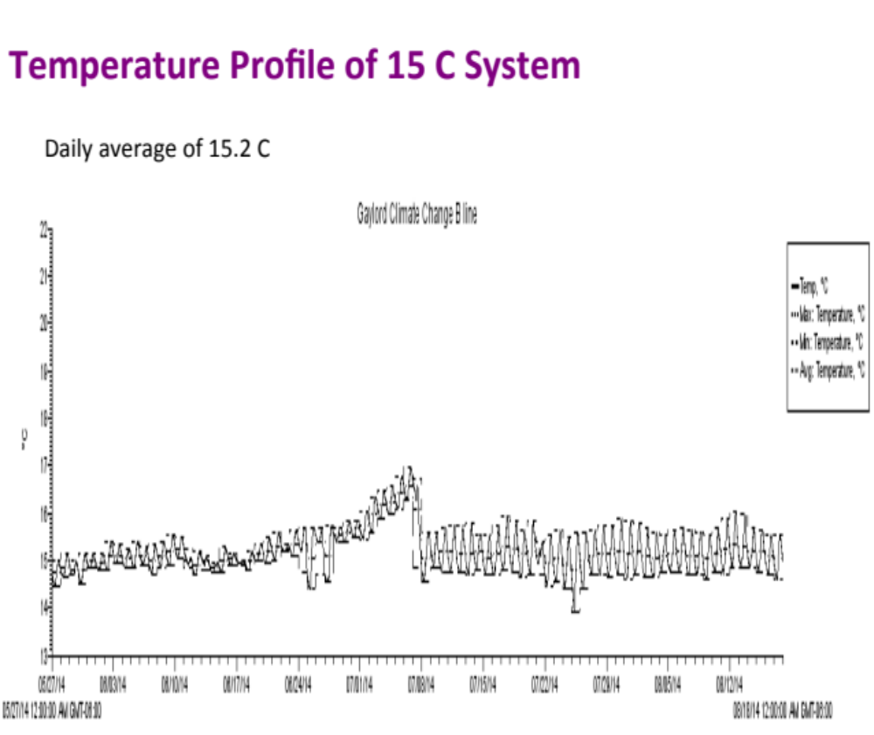
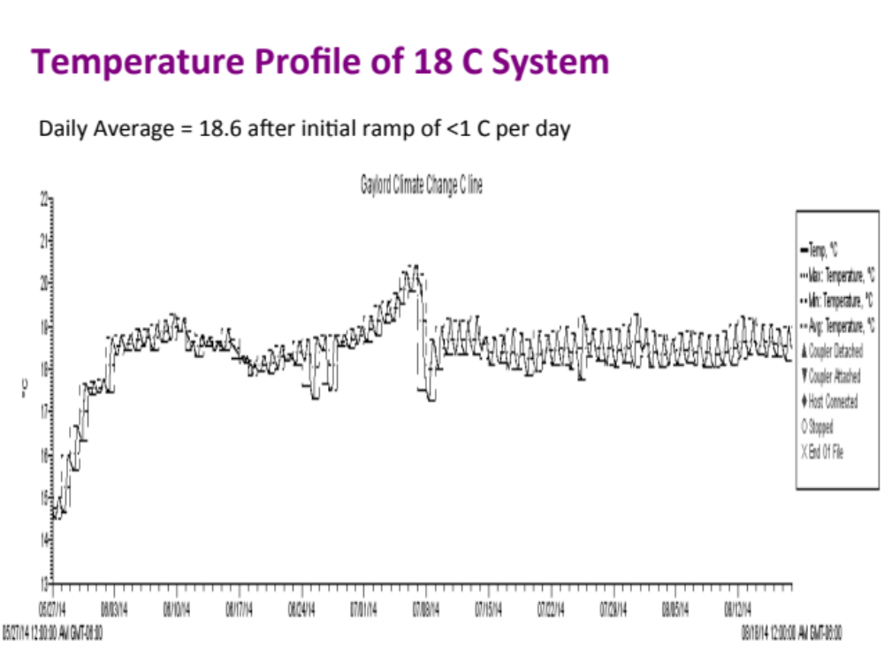
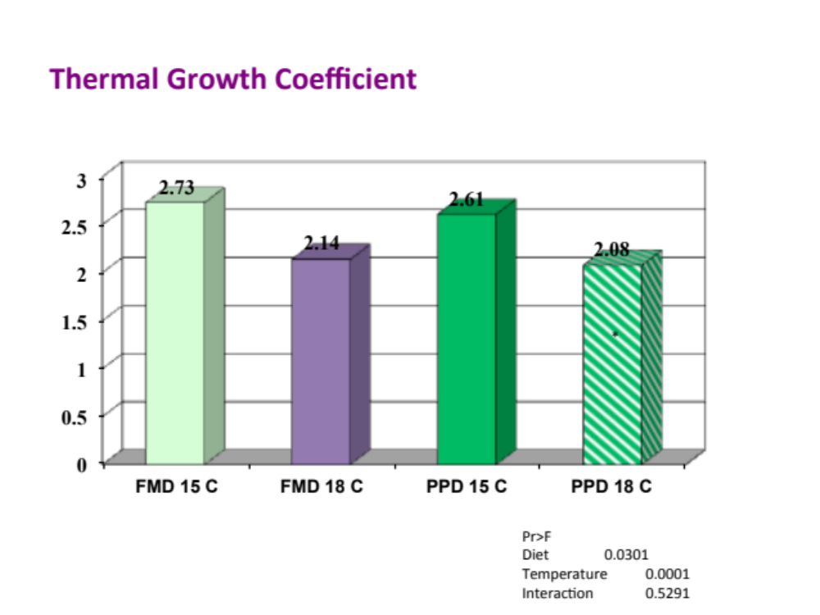
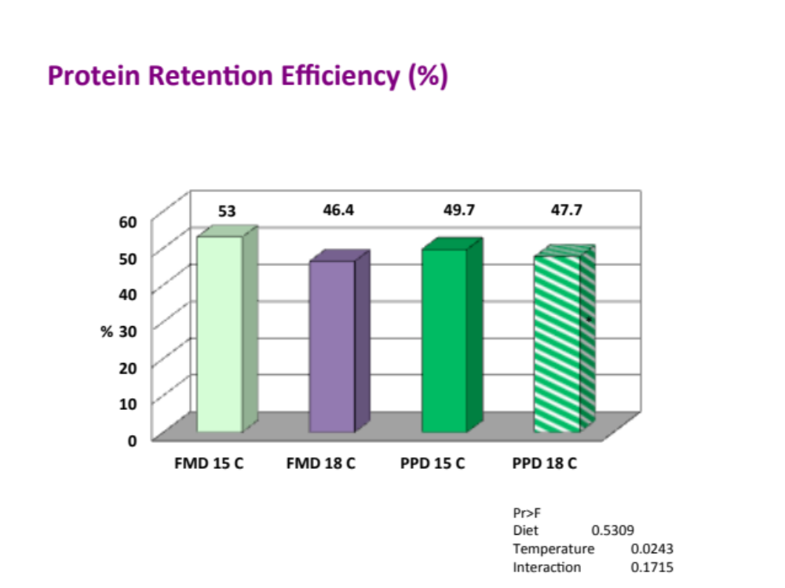
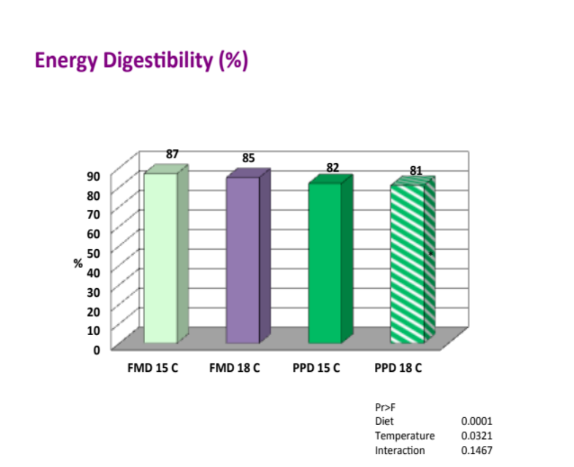




Changes in morphological and microbial characteristics of cultured rainbow trout (Oncorhynchus mykiss) in relation to diet types
and different culturing temperatures
Names
Montana State University, Bozeman, MT 59715
Overview
Cultured Temperature profiles
Microbial profiles
Culture temperature is an important factor in fish management. It affects metabolic rates of rainbow trout, but how it altered nutrient utilization is not fully understood.
Two diets were formulated and balanced to supply about 4700 calories/g digestible energy with 40% digestible protein and 20% lipids.
Rainbow trout were fed the experimental diets for 12-week period in a recirculating system at maintained at normal temperature of 15°C and elevated temperature of 18 °C.
Growth, nutrient utilization, microbial profiles and metabolomics of fish fed the experimental diets were analyzed .
Growth characteristics and nutrients retention of rainbow trout at 15°C and 18°C temperatures
Experimental diets
 | Fishmeal Diet | Plant protein Diet
MFM SS mean | 16.65 | 0.00
Chicken 42 - ADF | 13.02 | 0.00
Blood meal | 4.00 | 0.00
Corn Protein Concentrate | 9.50 | 20.30
Soybean Meal 48%CP | 10.00 | 10.00
Soy Protein Concentrate | 0.00 | 20.30
Wheat flour | 21.98 | 17.83
Menhaden fish oil | 15.37 | 18.34
Lecithin | 1.00 | 1.00
Stay-C 35 | 0.15 | 0.15
Monocalcium phosphate | 1.40 | 3.80
Choline Cl 50% | 1.00 | 1.00
DL-Methionine | 0.49 | 0.64
Lysine HCl | 2.19 | 3.11
Threonine | 0.47 | 0.75
Yttrium oxide | 0.10 | 0.10
Vitamin Mineral premixes and supplements | 2.83 | 2.83
Fish weight was affected by diet types. Growth was higher in fish fed fishmeal diet than those fed
PPD diet. Elevated temperature reduced fish growth in both diet. Protein retention efficiency and
Digestibility of energy was reduced by elevated temperature in both diet types.
Acknowledgement
Microbial profiles
National Institute of Standards and Technology Hollings marine Laboratory, Charleston, SC

